Slide 1

Social Media Performance Analysis: Unlocking Insights for Success
Presented By – Dinod Imanjith

Slide 2

Project Overview: Unpacking Social Media Metrics
This project leveraged a comprehensive dataset of social media metrics across various platforms. Our primary goal was to understand engagement patterns and develop predictive models for future performance.
Exploratory Data Analysis (EDA)
Model Building
Handling missing values
Regression & Classification
Modeling
Outliers Handling
Feature Engineering
Dimensionality Reduction
Encoding, Scaling and
Standardization
Clustering

Slide 3


EDA - Exploratory Data Analysis 01. Handling missing values and Outliers
Handling Missing Values
There were no missing values or duplicate values to be removed
Handling Outliers
No statistical outliers were found using IQR or the 3-sigma method. However, using a domain-specific rule checking for items with disproportionately high likes, comments, or shares compared to views helped identify 230 meaningful outliers

Slide 4
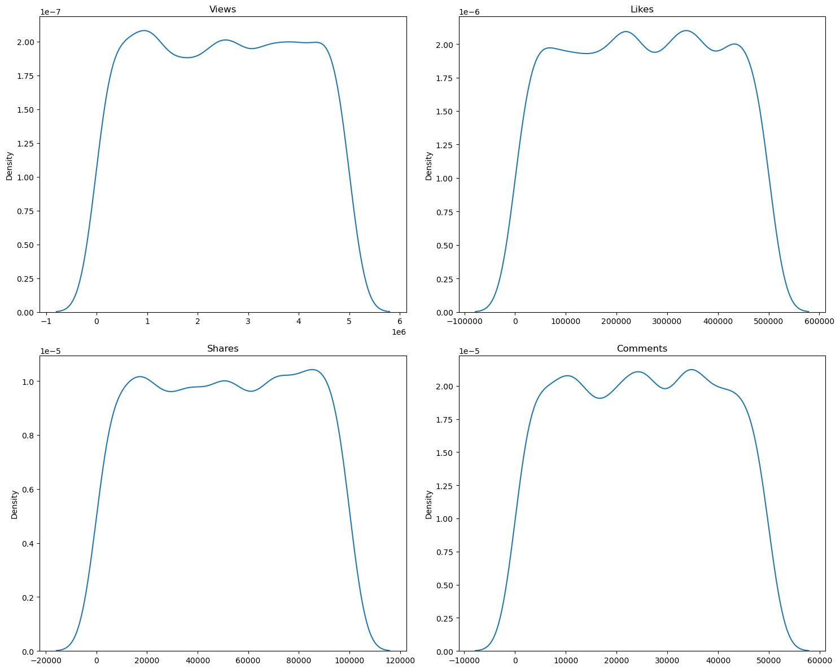
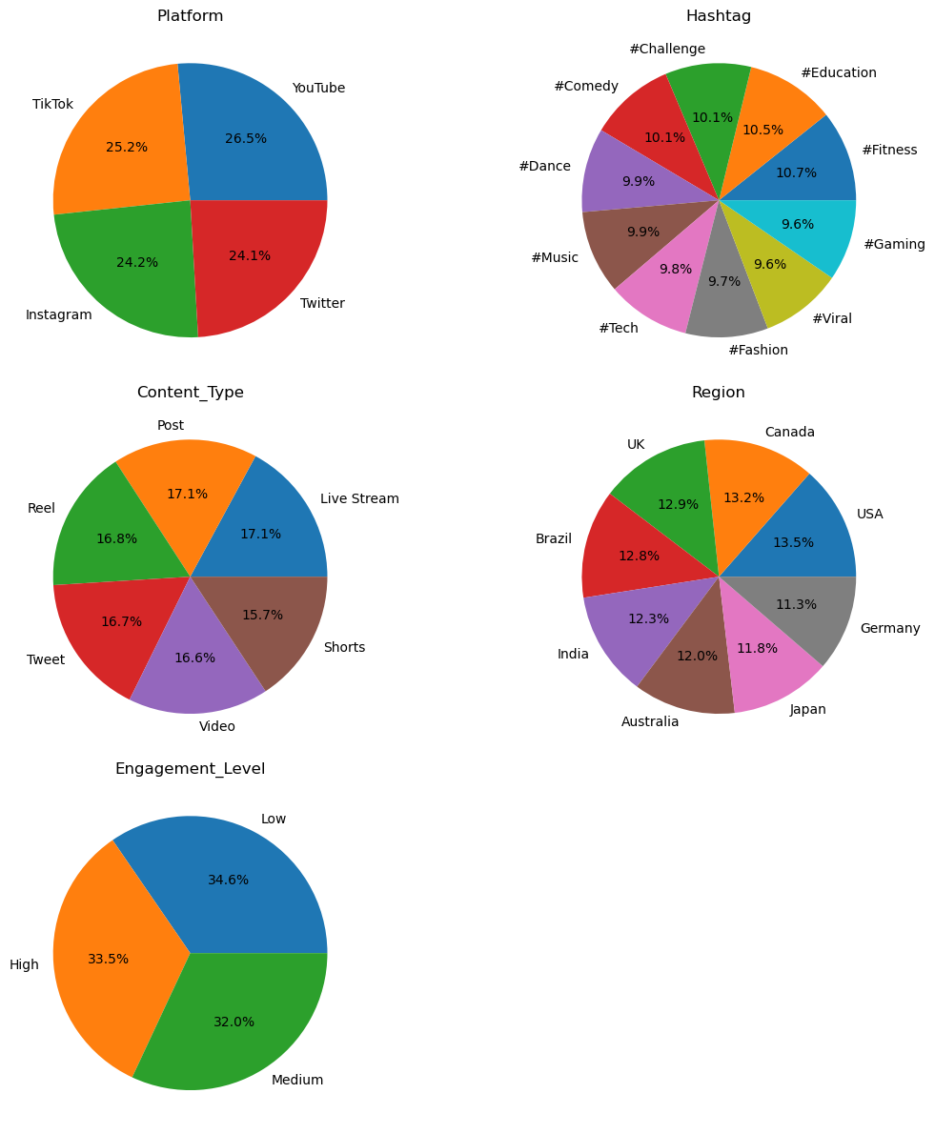
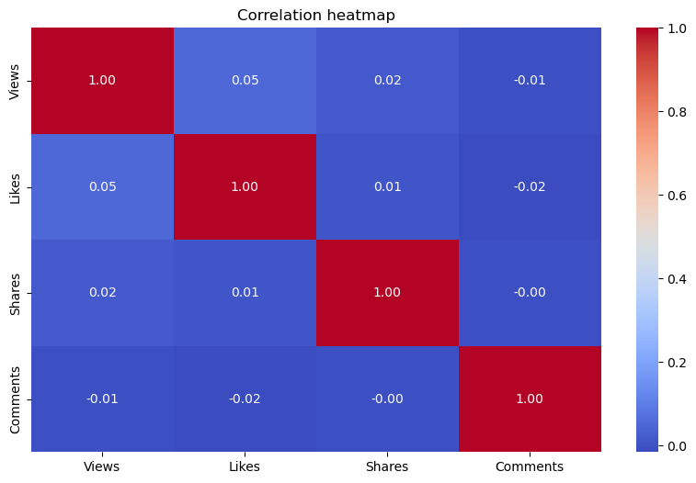
Data Visualization – Part 01

Slide 5
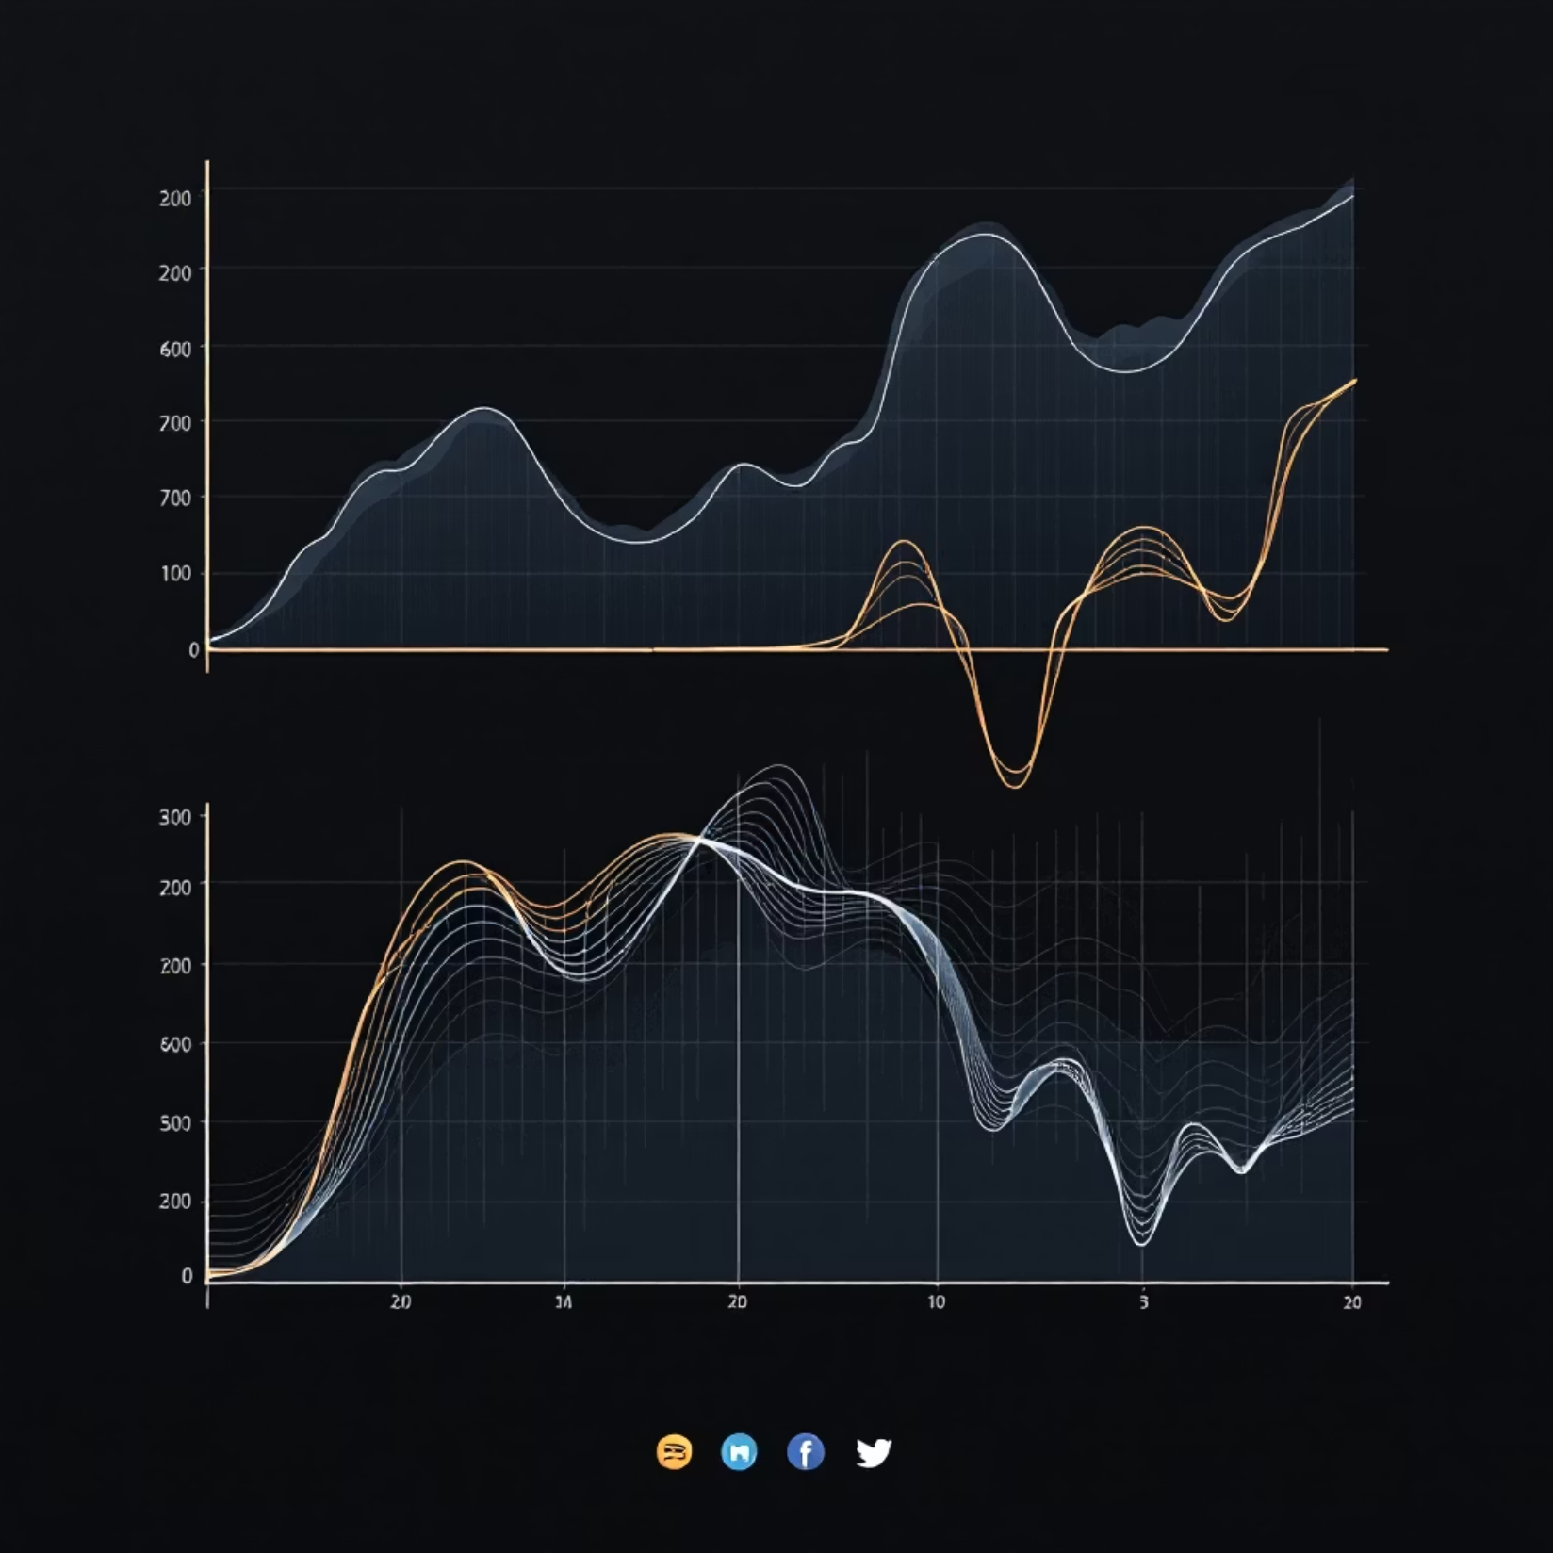
02. Feature Engineering
To improve signal strength and uncover deeper relationships within the data, we engineered several new features.
Like Rate: Likes per view, indicating content appeal.
Share Rate: Shares per view, reflecting content virality.
Comment Rate: Comments per view, showing audience
interaction.
Engagement Rate: Combined likes, shares, comments per
view.
Total Engagement: Absolute sum of interactions
(with & without shares).
Platform-Normalized Views: Adjusting for platform-specific
reach variances.
Purpose: The goal was to enhance the predictive power of
models. However, relationships still remained weak, indicating
inherent challenges with the original dataset's structure.

Slide 6
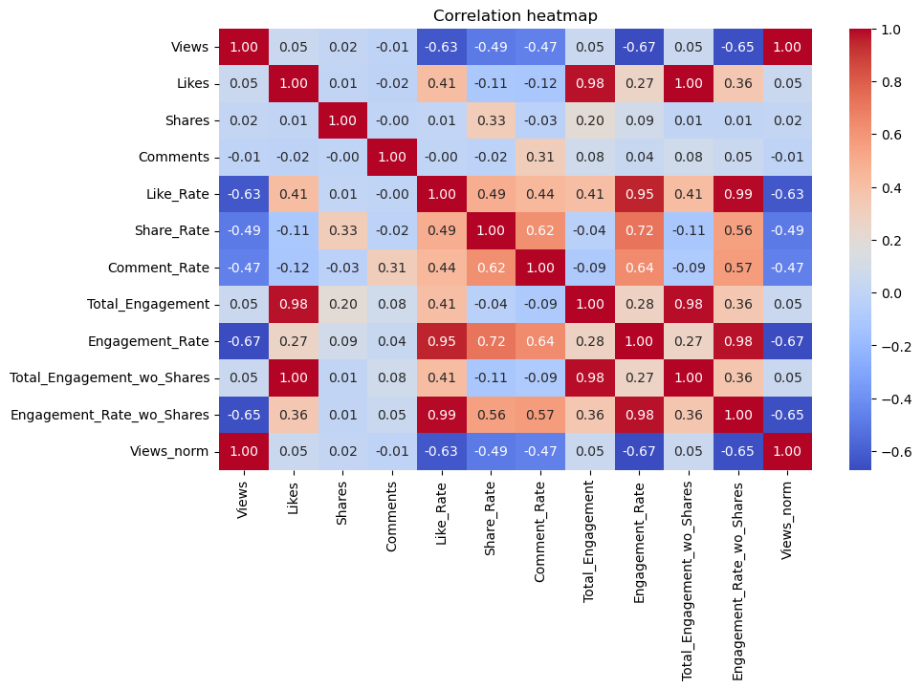
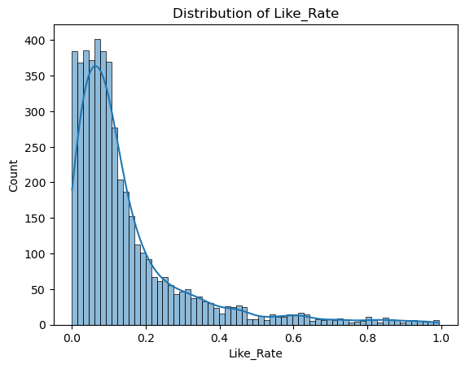
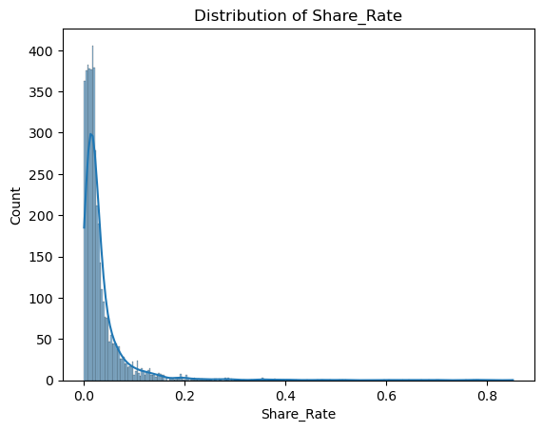
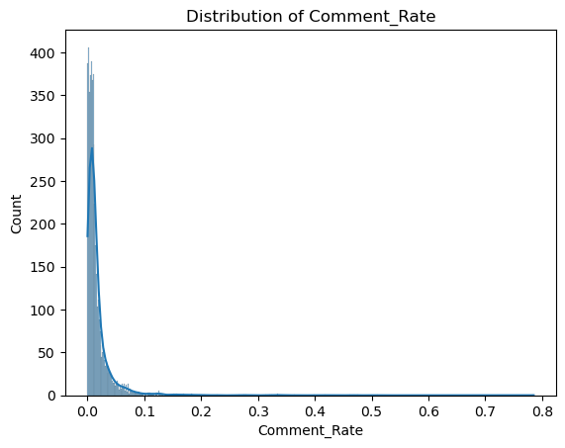
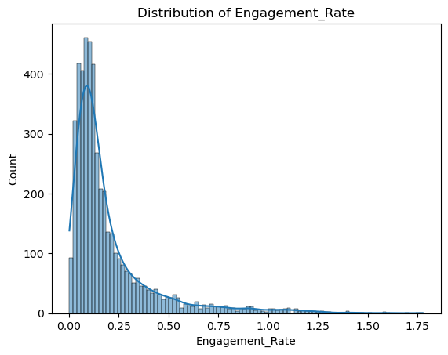
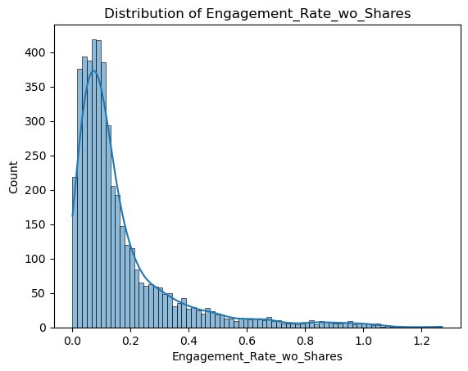
Data Visualization – Part 02

Slide 7
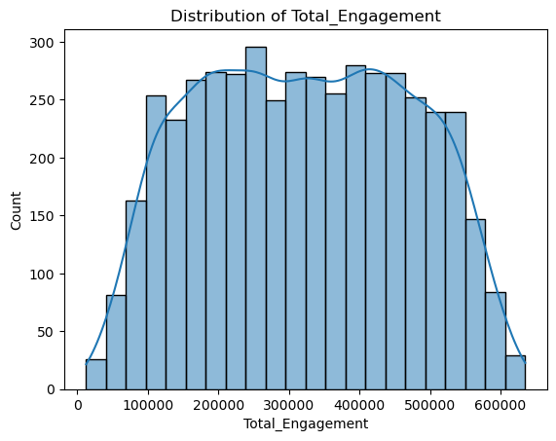
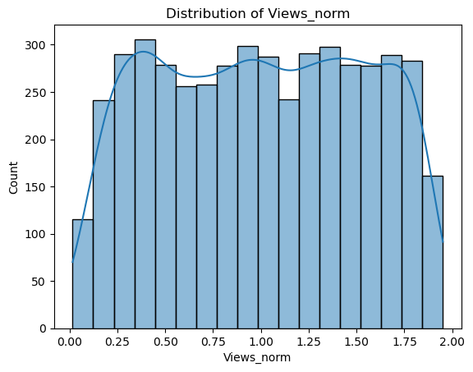
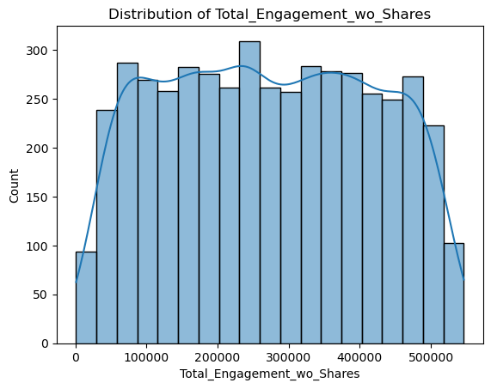
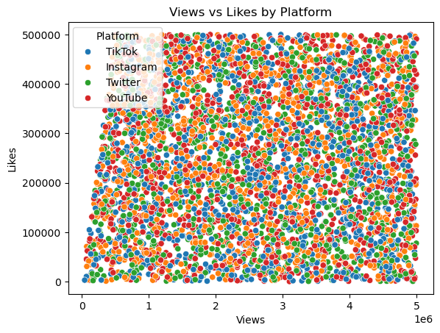
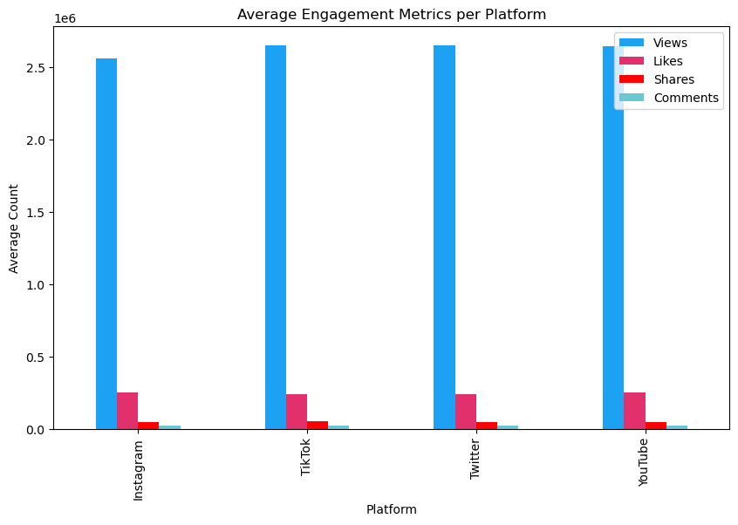
Data Visualization – Part 02

Slide 8
03. Scaling, Encoding & Standardization
Encoding Categorical Columns
Scaling Numerical Columns
Some columns like Platform, Hashtag, Content_Type, and Region are text values. Machine learning models cannot work directly with text, so these columns were converted into numerical form using One-Hot Encoding.
Numerical columns (such as Views, Likes,
Shares, Comments) were scaled using
Min-Max Scaling.This transforms all values
into a range between 0 and 1, which helps
the model learn more effectively.
Ordinal Encoding
Standardization
For classification, the target column Engagement_Level was converted into numeric labels using Ordinal Encoding, because the model requires numbers instead of text labels.
Standardization was applied only for the clustering model to scale numerical features to have zero mean and unit variance, which helps distance-based algorithms work properly.

Slide 9

Model Building ( Regression, Classification, Clustering)

Slide 10
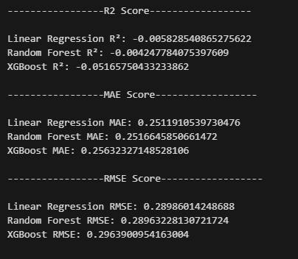
Regression – ( Predicting Shares )
Trained three different models, Logistic Regression, XGBClassifier, and RandomForestClassifier using K-Fold cross-validation and GridSearchCV. The model evaluation results are measured using Precision, recall, F1 and Confusion matrix:

Slide 11
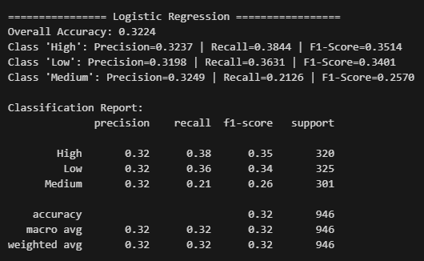
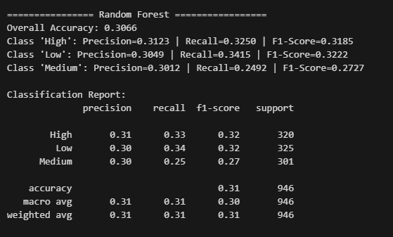
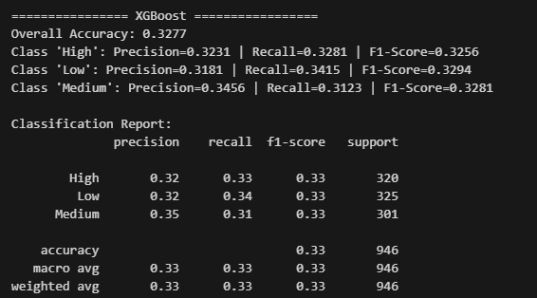
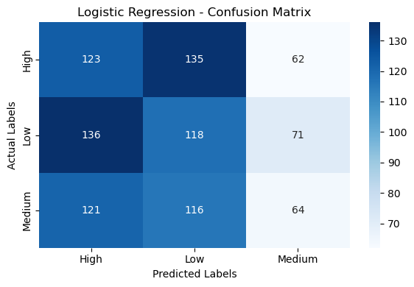
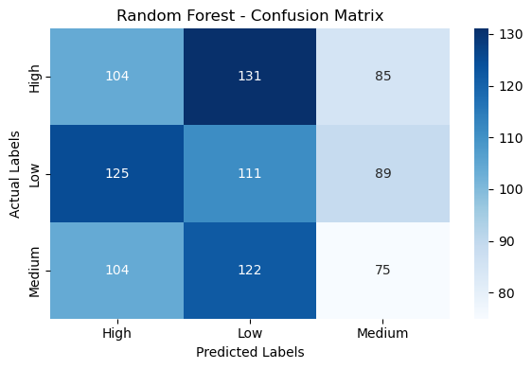
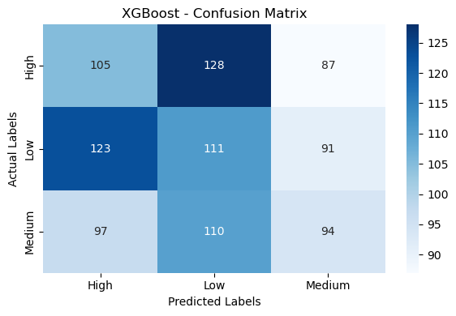
Classification – ( Predicting Engagement Level )
Logistic Regression
Random Forest Classification
XGBoost Classification

Slide 12
Exploring Data Structure: Dimensionality Reduction & Clustering
To uncover hidden structures or relationships, we employed dimensionality reduction and clustering techniques.
1
2
3
Dimensionality Reduction
Clustering (K-Means)
Clustering (DBSCAN)
PCA: Best component count was approximately 6, capturing limited variance.
PCA-based: Best clusters identified were 2, but with low separability.
PCA: Optimal parameters (eps = 0.222, min_samples = 3) yielded minimal stable clusters.
t-SNE-based: Best clusters identified were 3.
t-SNE: Produced a 3D embedding for visualization, offering some local structure.
t-SNE: Optimal eps ≈ 3.8.
UMAP-based: Best clusters identified were 3.
UMAP: Optimal parameters (eps ≈ 0.292, min_samples = 6).
UMAP: Showed slightly better structure than PCA/t-SNE, but overall data randomness persisted.
Overall: Clusters were not meaningful and lacked clear differentiation.
Overall: DBSCAN generated many noise points and few stable clusters, further confirming data's high randomness.

Slide 13
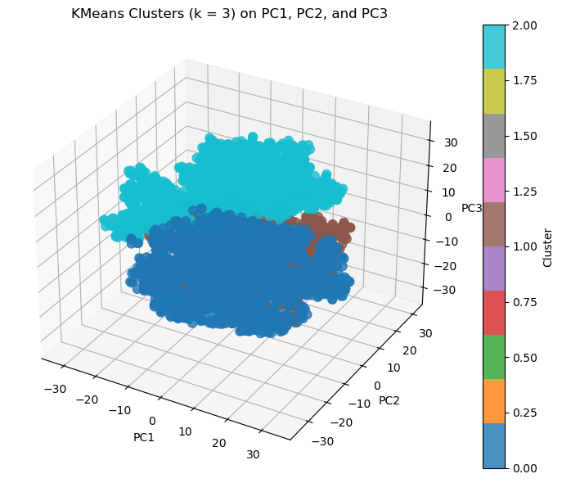
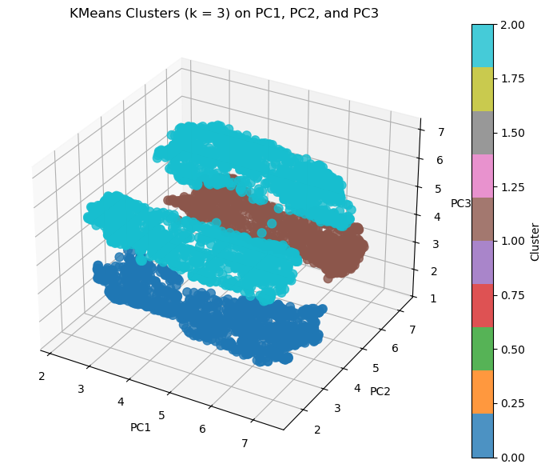
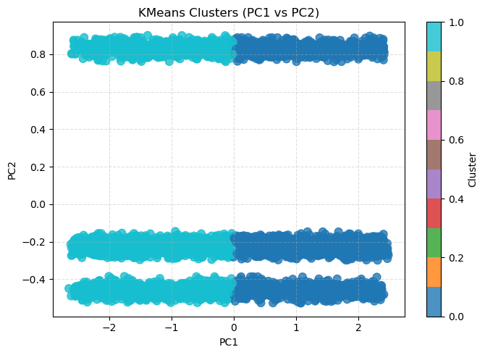
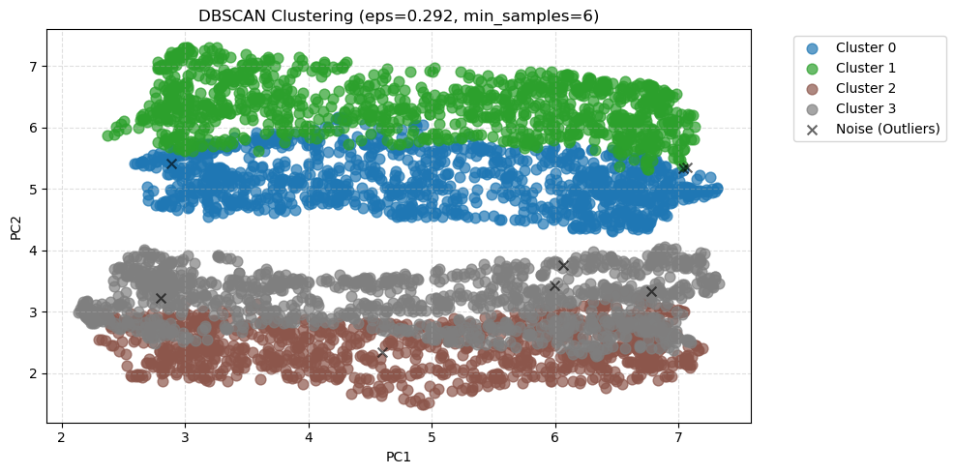
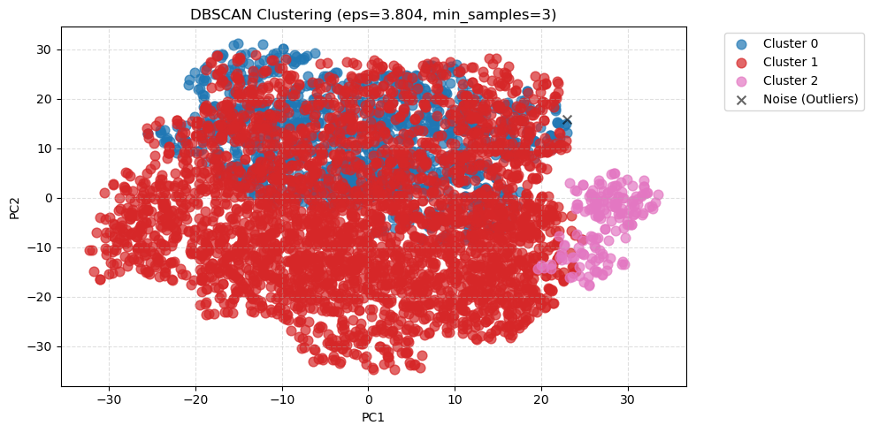
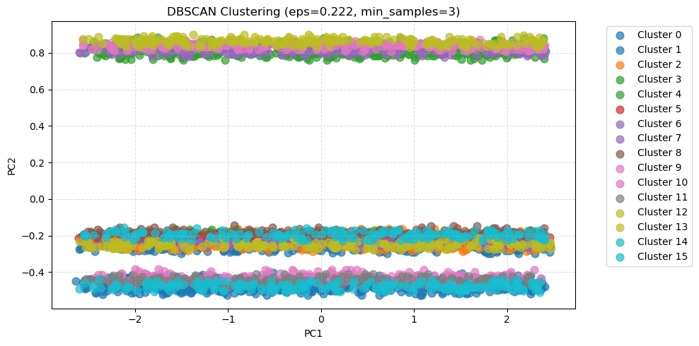
K-means
PCA
T-SNE
UMAP
DBSCAN

Slide 14

Strategic Recommendations for Enhanced Social Media Analytics
01.
Collect More Data
The current dataset is too small and random to infer reliable patterns or build robust models. Expand data collection scope and volume.
02.
Improve Data Quality
Implement stricter data validation to detect unnatural values earlier and validate platform-specific metric ranges more rigorously.
03.
Add High-Impact Features
Enrich the dataset with contextual features such as posting time & day, content length, topic categories, hashtag quality, audience demographics, and video/visual properties.

Slide 15

Thank You !

